Slide 1
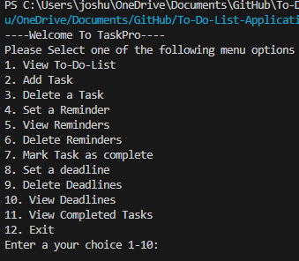

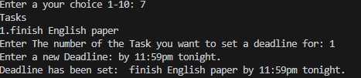
TASKPRO: TO-DO-LIST APPLICATION
Options Menu
"TaskPro: Your Gateway to Proactive Productivity"
This is a simple to-do-list application that helps you with managing tasks
Users will be able to add tasks, delete tasks, set reminders, set deadlines for different tasks, and other different options like viewing upcoming deadlines and marking them as complete.
By Josh Mccrary
GitHub Repository Link: https://github.com/ksu-is/To-Do-List-Application-Project
Set Reminder
Set Deadline

